Slide 1
B Tech Integrated In Plant Training Presentation A.Y. Semester:
Presented by : Anirbaan Ghatak, C026.
Organization Name : E-RevBay Pvt. Ltd.
Industry Mentor : Mohit Vora
Faculty Mentor : Supriya Agrawal
Under the guidance of : My Caffeine Addiction

Slide 2
Roadmap
About the Organization
About the Department
About the Project/s
Description of technical tasks
Brief of new skills gained
Overall learnings
Comments and Future Plan
6th May 2023

Slide 3

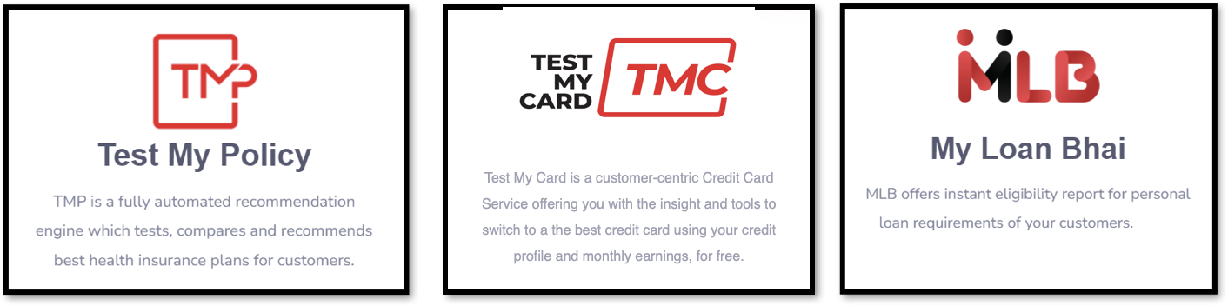
E-RevBay Pvt. Ltd.
ERB is a Fin-Tech company that operates on a B2B2C business model. ERB has a subsidiary called Finqy which provides partners a wide range of financial products to offer to their customers.
The company's mission is to simplify the complex processes that make up financial products and services, allowing customers to make informed decisions about their financial future
Notes:
About the company from the final Report

Slide 4
The Tech Department
ERB's tech department is crucial to the company's success. Their team of talented developers and engineers focuses on innovation and simplifying financial processes through cutting-edge technology. They are committed to providing a superior user experience, ensuring that ERB stays ahead of the curve in the rapidly evolving Fin-Tech industry in India.
Notes:
From the final report get a pic here from Dall-e

Slide 5
Projects (Completed)
Credit Analysis Report
PNB bank Insurance RPA
Data Verification

Slide 6
Credit Analysis Report
Robotic Process Automation
Data Verification
An Automated system for generating credit analysis reports. The reports provide customers with loan or top-up recommendations based on their credit history and current loan obligations from their Equifax report.
Power Automate program used for PNB Bank's insurance completion tracking website.
Verifying whether an array of numbers was active and available on WhatsApp. The process of verification determines whether the numbers presented to us were registered and actively using the messaging platform or not.
Notes:
CAR: The goal of the system is to streamline the credit analysis process, improve the efficiency of loan recommendations, and increase the accuracy of credit evaluations.
RPA: The goal of the task was to improve the program's functionality, eliminate bugs, and simplify the user experience. The resulting improvements help ensure that insurance completions are accurately tracked and efficiently managed.
DV: The goal of the task was to ensure the accuracy and reliability of the data, providing our team with the necessary information to market to the target audience Also to determine the fake and duplicate data.

Slide 7
Projects (Ongoing)
TMCC
Car Pe Loan
MLB-TML
Equifax Excel Dashboard

Slide 8
Test My Credit Card
MLB-TML
Equifax Excel Dashboard
Car Pe Loan
Conduct website scraping to collect all details about currently available credit cards in India. The collected data was standardized for use in the recommendation engine
Determine the accurate price range of a car based solely on its registration number. This information was required to determine the loan amount that could be offered against the car.
Create a clubbed report of the two services provided by the company, namely MLB and TML. The report was designed to provide customers with a comprehensive overview of their financials and offer recommendations to help them improve their credit scores
Develop the backend code for a new dashboard created in PowerBI. The dashboard was designed to help relationship managers efficiently review their customers' financial data.
Notes:
TMCC: The goal of the task was to create a comprehensive database of credit cards available in the Indian market, which could be utilized by the recommendation engine to suggest the most suitable credit card options to users. The resulting database provides accurate and up-to-date information on credit card options available in India, ensuring that users receive the most relevant recommendations.
CPL: The process involved collecting data from various sources, including government databases and car selling platforms, and using web scraping to get the data and determine the car's value.

Slide 9
Description of Technical Tasks
Concise overview of the technical tasks assigned for a project

Slide 10

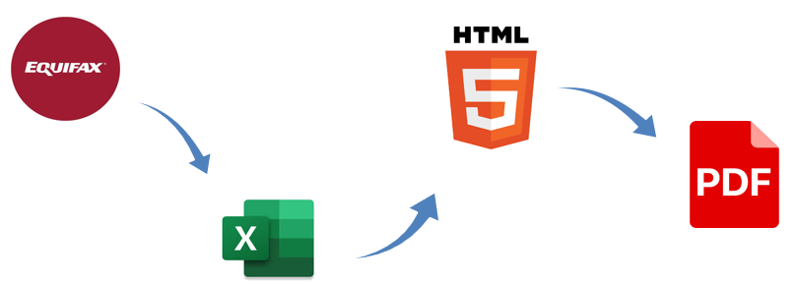
Credit Analysis Report
Credit Analysis Report: document that summarizes the person's financials and recommends ways to increase their funding
Read the Equifax using PyPdf2 Module available in Python.
Assisted in the CSS part of the Main CAR report webpage.
Using HTML, CSS and JavaScript developed the Login page.
Connected the Login Page with Firebase Authentication for seamless and serverless Authentication.
Notes:
Talk About The first pdf to XML but then realizing it just dumb

Slide 11
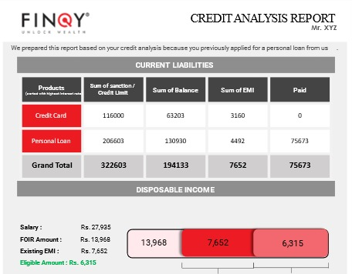

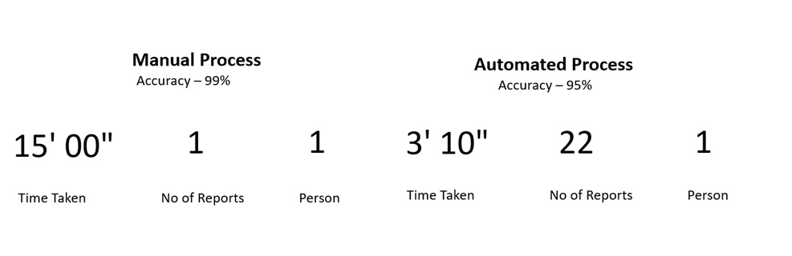
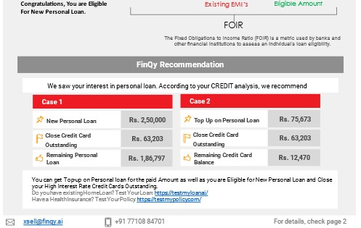
Deployment of the Website Created for CAR reports in Azure Web Apps Service.
Azure Web Service is a cloud-based platform that allows developers to deploy, manage, and scale web applications and services with ease
Time Taken for the Automated Process vs Manual

Slide 12

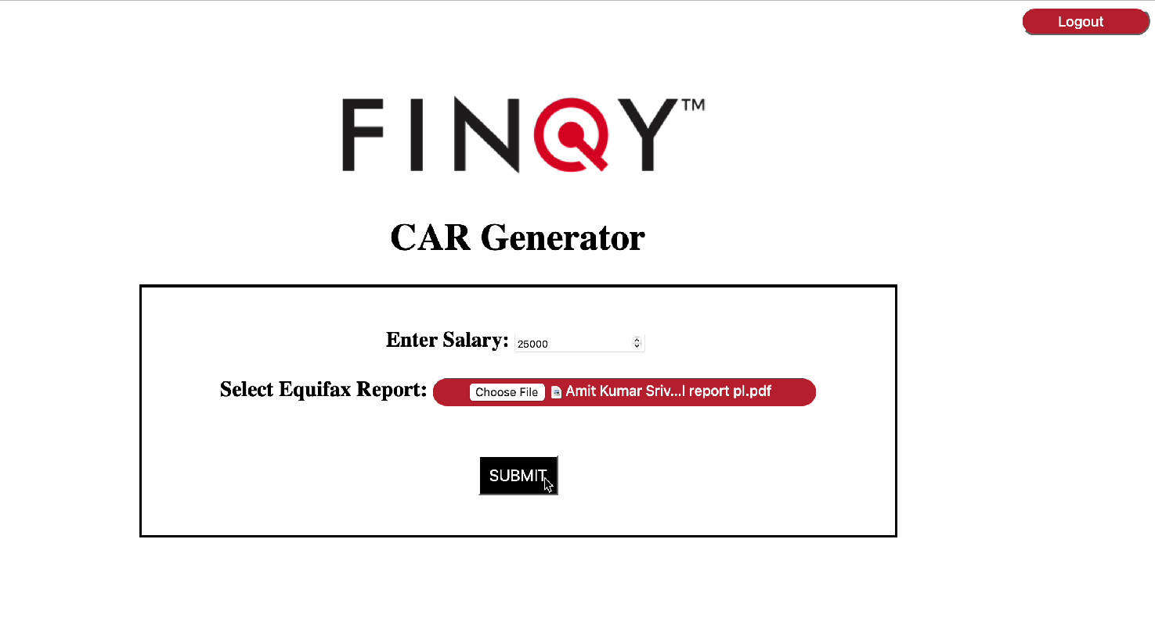
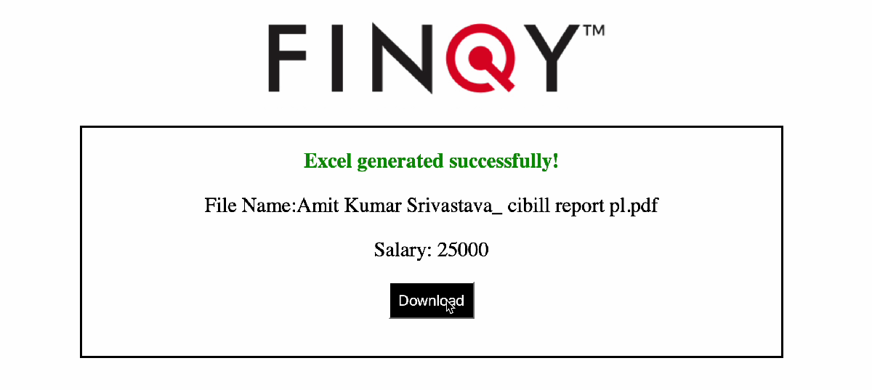
The CAR Website

Slide 13
Robotic Process Automation _{(RPA)}
RPA: Technology that automates repetitive tasks using software robots
Learned how to use Power Automate which cloud-based service that enables users to create automated workflows between apps and services.
Understood how API’s function which further enhanced the abilities and proficiency in utilizing them for various projects.

Slide 14


Data Verification
Utilizing the skills gained from a previous project, I contributed to the development of the Power Automate Flow for mobile no. verification.
An attempt was made to scale the Power Automate Flow by running it on Azure Virtual Desktop and Virtual Machine. However, it was observed that these methods were slower than running the Flow on a local PC
In an effort to improve efficiency, a transition was made from Power Automate to a Python code with the aid of the PyAutoGUI module, which is similar to Power Automate. The Python code was attempted to be executed on an Azure Virtual Machine, but it was observed to be slower than running it on a locally available PC.

Slide 15

Test My Credit Card
To Gather data of all the available credit cards in present in the Indian market, web scraping was performed.
Python Module Selenium was used for this.
Then using Pandas the fetched data was converted into an excel for cleansing.
The Acquired data did have a lot of unnecessary information in it, which was cleaned manually and using Pandas.
An initial attempt to classify cards and recommend the best ones for a certain area using K-nearest neighbors was done but it did not yield the desired results.

Slide 16
Car Pe Loan
Utilizing the skills acquired from then previous project web-scraping for the price range of used cars was a much easier process
Integrating the ScoreMe API which provides the curcial details of the solely using Registration Number into the Selenium code was the main challenge of Phase 1.
Using Pandas and other interesting python module the integration of the API with the code was done as a Part of Phase 1.

Slide 17
MLB-TML
Customer financial details which is the heart of this was fetched form the companies database using MySQL , The database only stored the entire raw JSON of the customer.
A codebase was developed to fetch the JSON of certain customers using Python and then Using Pandas was converted into a Excel Sheet which was more organized.
A new report format was made, which will be sent to the customer with his financial details in it and the recommendations on how to improve their credit scores.

Slide 18
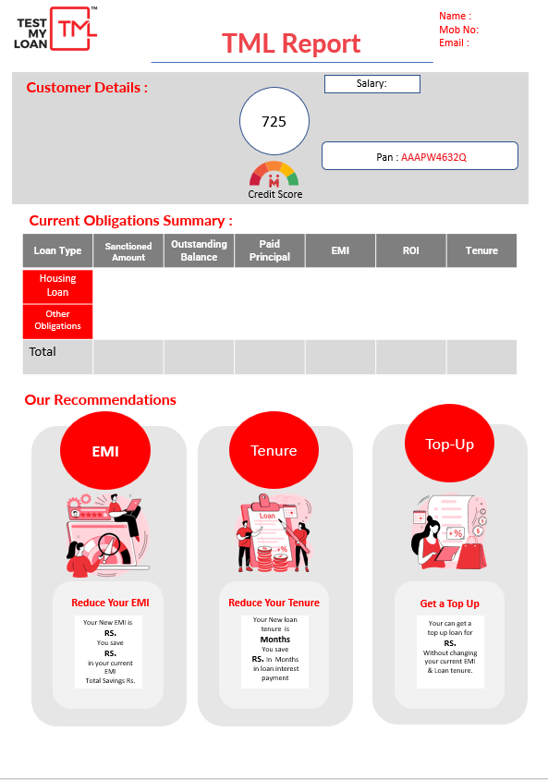
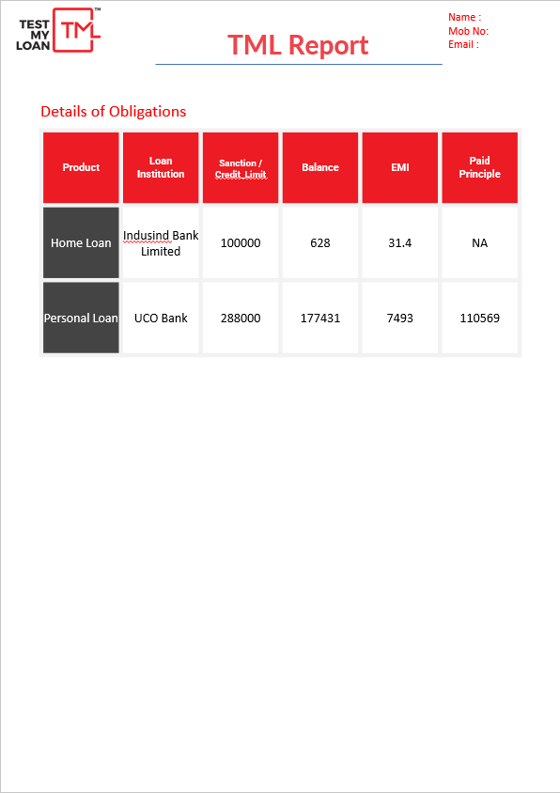
The MLB-TML Report Format for Customer

Slide 19
Equifax Excel Dashboard
Equifax Excel Dashboard’s back-end is powered by the same codebase which powers the MLB-TML report.
This Dashboard is made for the Relationship manager to analyze the customers finances easily.
The Dashboard is made entirely in Microsoft’s Power BI which is a business analytics service that provides interactive visualizations and data insights to enable data-driven decision-making.
Notes:
Maintaining some software engineering law or axiom or something

Slide 20
Skills Gained
Python
Flask Framework
Firebase
SQL
Power Automate
Excel
Azure Virtual Machine
Web Scraping
Robotic Process Automation
Time Management
Critical and Out-of-the-box Thinking
Communication
Adaptability
Teamwork
Patience
Notes:
Skills Gained frfr: Carrom, roasting and getting roasted, new traumas :), Procrastination and making Friends??

Slide 21
Overall Learnings
During my internship at ERB, I had the opportunity to work on a variety of exciting projects that allowed me to develop my technical skills and gain valuable experience in the financial technology sector. One of the highlights of my internship was working on the credit analysis report automation project, where I used Python, Flask, and CSS to automate the report and improve efficiency and accuracy.
I also gained experience in fixing bugs in the Power Automate program and learned about the importance of testing and attention to detail in ensuring the accuracy of complex systems.
As a member of the Data team, I gained valuable knowledge about data verification and worked on scalability of part of project.
Additionally, I learned about market research techniques, data analysis tools, and communication and presentation skills in TMC and Car pe Loan.
Overall, my internship at ERB was a fantastic opportunity to apply my technical skills in real-life situations and contribute to the development of financial products and services.

Slide 22
Conclusion and Future Planning
I gained extensive knowledge and experience in the financial technology industry. Working on various teams, automating credit analysis reports, fixing bugs in complex systems, and learning web crawling techniques.
Along with experience in market research, communication, and data analysis. Through these experiences, I gained a greater understanding of the importance of testing, developer ethics, and effective and concise software development.
Overall, my time at ERB allowed me to contribute to the development of financial products and services while expanding my technical expertise in real-world settings which will me improve as a rookie software engineer.
Notes:
A/C doesn’t fucking work there are more cockroaches than employees and the paying system is honest to god fucked matlab bhai kya hai yeh chutiyap
Aur idar bevde or bhavde or koi koi dono hai

Slide 23
Questions??

